Slide 1
CloudFront: Your Content Delivery Superhero!
Accelerating Content Delivery on AWS (CDN Strategies, Security, and Scalability)

Slide 2

Introduction to CDN & CloudFront
What is a CDN?
A Content Delivery Network (CDN) is a globally distributed network of servers that delivers web content (images, videos, scripts) to users based on their geographic location.
What is Amazon CloudFront?
AWS’s CDN service that integrates with other AWS services (S3, EC2, Lambda) to accelerate content delivery with low latency and high transfer speeds.

Slide 3
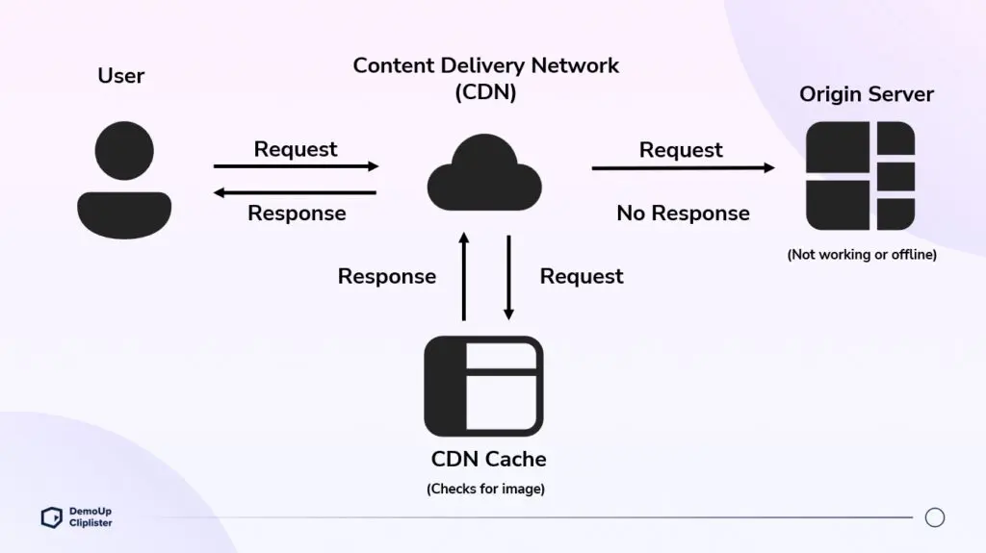

Slide 4
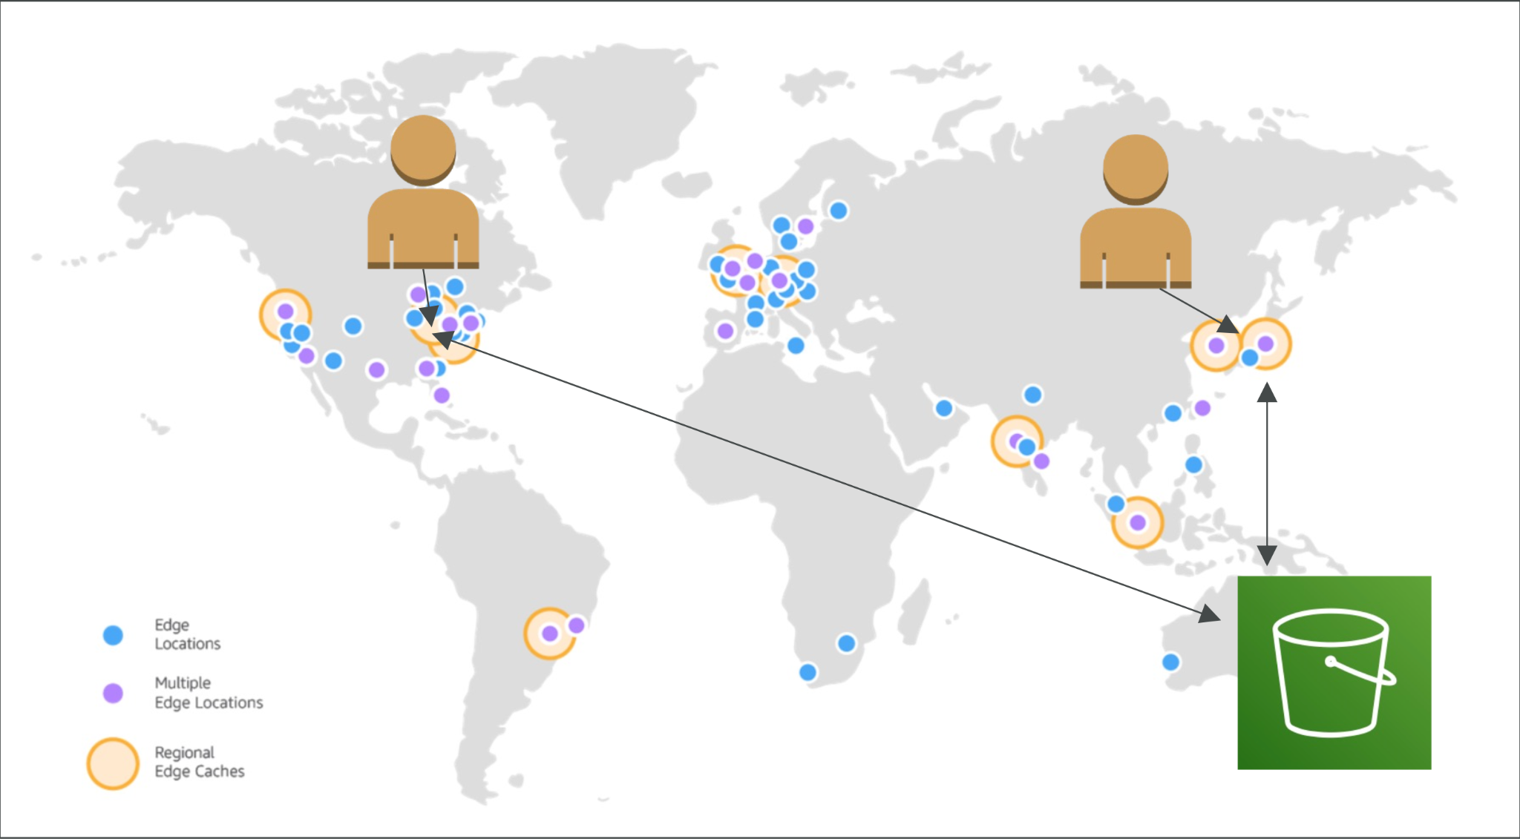

Slide 5
Key Features of CloudFront
Global Edge Locations: 400+ edge locations worldwide.
Caching: Stores content closer to users for faster delivery.
Security: Integration with AWS Shield (DDoS protection), SSL/TLS encryption.
Dynamic Content: Supports both static and dynamic content.
Lambda@Edge: Run serverless code at edge locations.

Slide 6
CloudFront Use Cases
Accelerate Static Websites: Hosted on S3.
Live/On-Demand Video Streaming: Integrates with AWS Media Services.
APIs and Dynamic Content: Caching API responses.
Security: Block malicious traffic with AWS WAF.

Slide 7
Security with CloudFront
SSL/TLS: Encrypts data in transit.
AWS WAF: Block SQL injection, XSS, etc.
Signed URLs/Cookies: Restrict access to private content.
DDoS Protection: Via AWS Shield Standard/Advanced.

Slide 8
Pricing Model
Data Transfer Out: Cost per GB based on region.
HTTP/HTTPS Requests: Cost per 10,000 requests.
Lambda@Edge: Cost based on compute time and requests.
Free Tier: 1 TB/month data transfer + 10 million HTTP requests.

Slide 9
Best Practices
Use Cache-Control Headers to define TTL (Time to Live).
Enable Compression (gzip, Brotli) for faster transfers.
Monitor with CloudWatch Metrics.
Use Origin Shield to reduce origin load.

Slide 10
Setting Up CloudFront
Steps to create a CloudFront distribution.
Configuring origin, behaviors, and caching settings.
Deploying and monitoring CloudFront with AWS tools.

Slide 11
Summary
Amazon CloudFront is a powerful CDN solution.
Enhances performance, security, and scalability.
Seamlessly integrates with AWS services for a robust cloud architecture.

Slide 12
